Slide 1
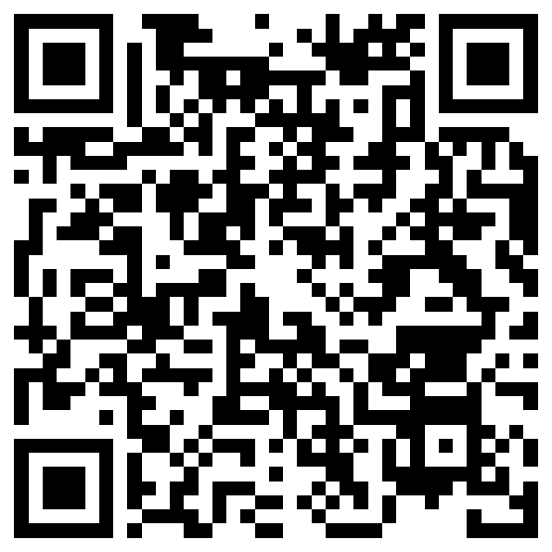



Whatsits in Winter: A Branching Options Exercise for Illustrating Natural Selection
Dan Johnson,
Wake Forest University
Notes:
1920 x 1080

Slide 2
Goals & Outline for Today
QUICK overview of lab background
Run thru Exercises 1, 2:
  Ex. 1: Demo whatsits feeding simulation
  Ex. 2: Forage different mouthparts, food items
Break
Talk through Ex. 3: Feeding in new habitats
Meta view: implementation, modifying activities, new ideas

Slide 3
Slide Annotations
Slides with a light yellow header box are information for instructors.
Slides with a light blue header box are the slides that we show students during a typical pre-lab lecture.

Slide 4
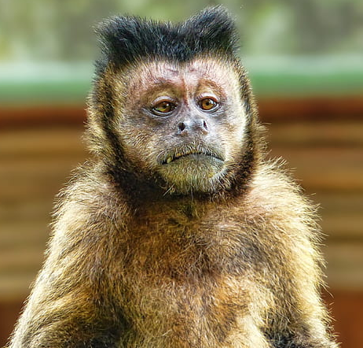
What Are Typical 1st-Year Students’ Misconceptions
About Natural Selection?
“I didn’t come from no monkey!”
Selection:
  Causes new variations to appear.
  Picks the one best solution to survival.

Slide 5
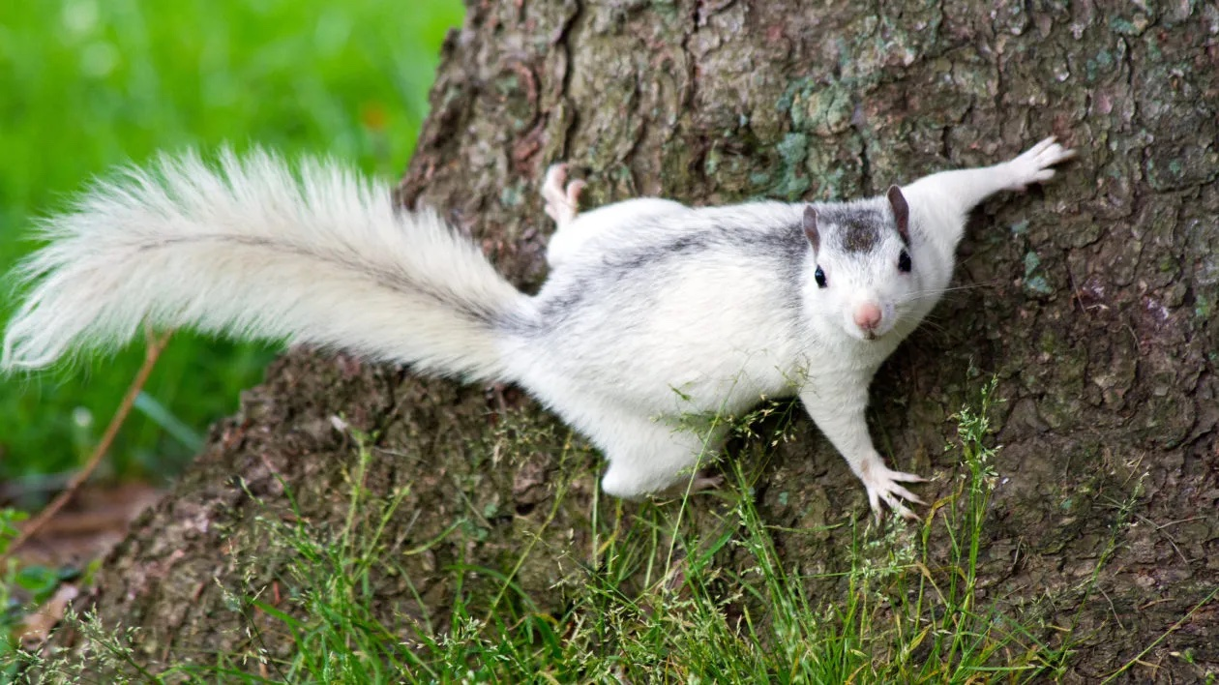
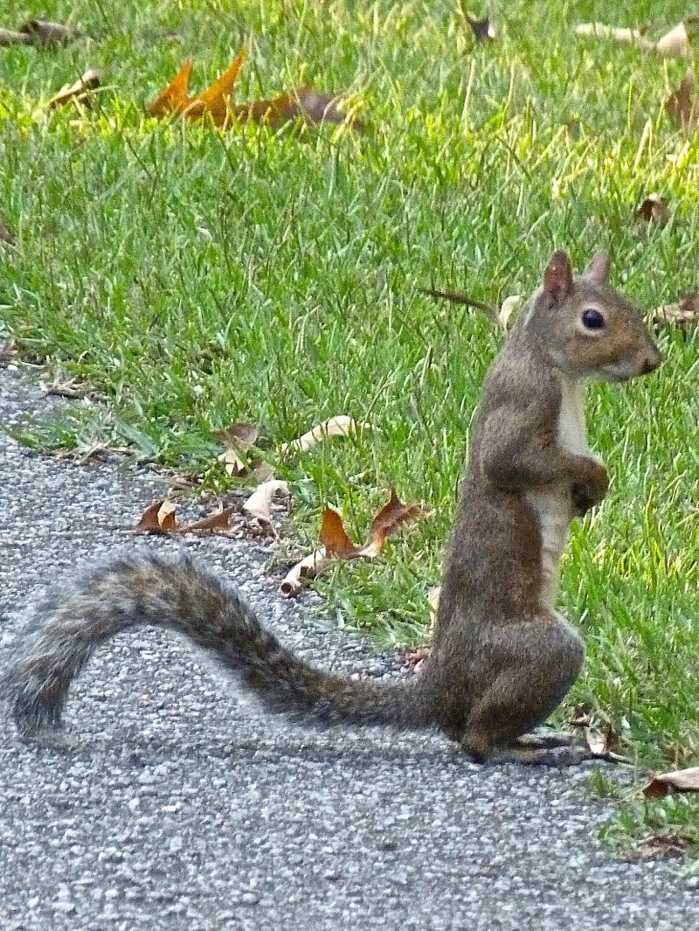
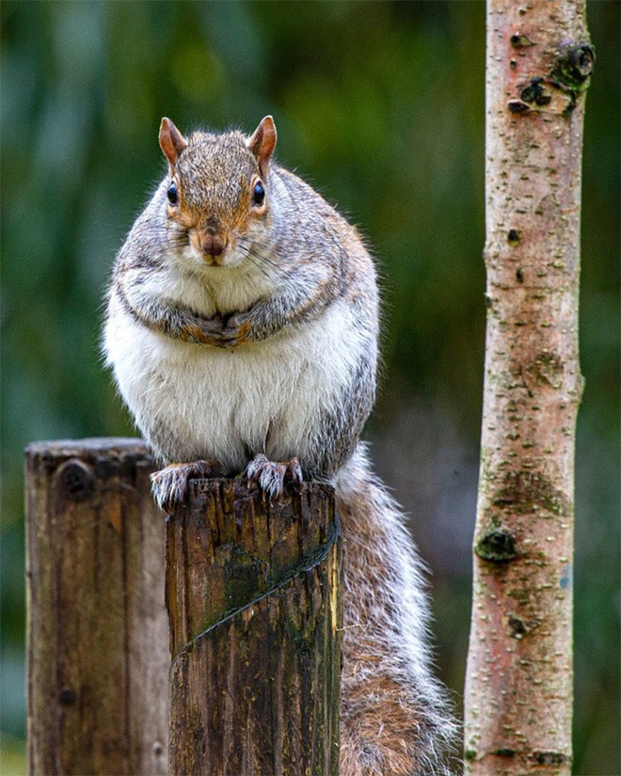
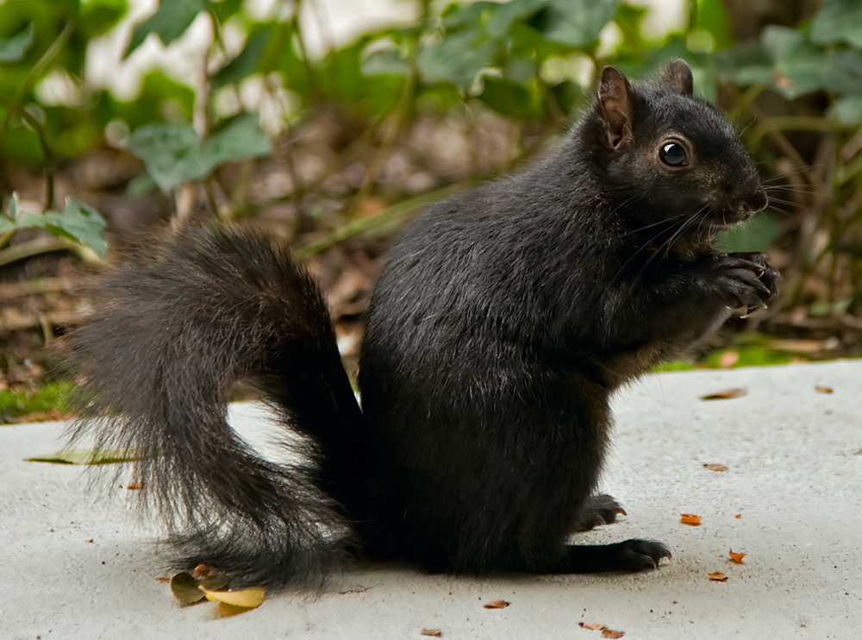
Eastern Gray Squirrels
Vary a LOT
Brevard, NC
College Park, MD

Slide 6
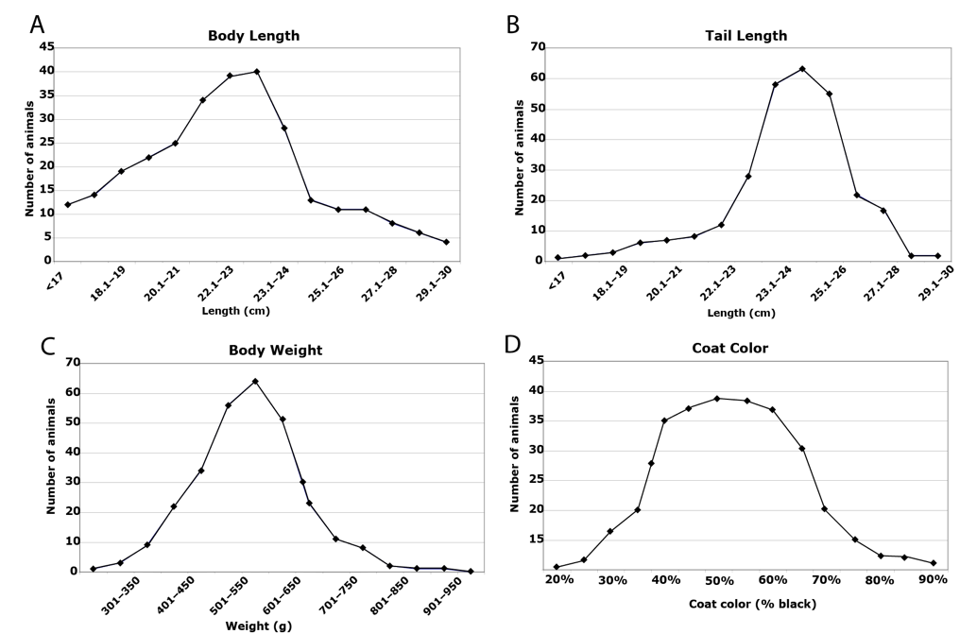
Our Model: Gray Squirrel Diversity on Campus
We scored 268 squirrels for 4 traits:
  Body length
  Tail length
  Weight
  Coat color
Each trait shows a range of variation

Slide 7
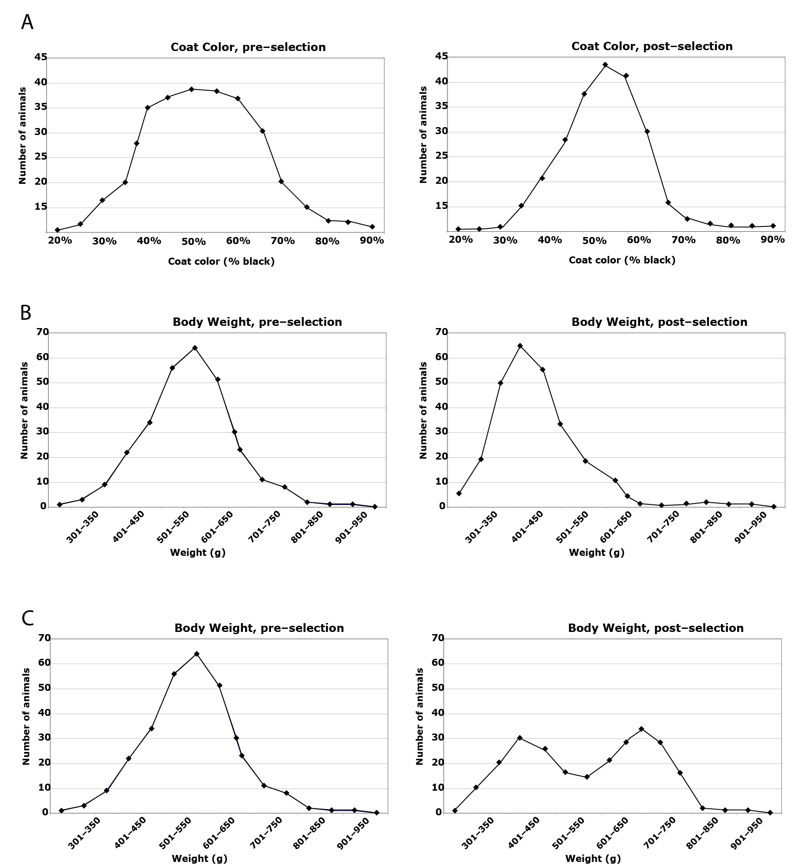
Examples of Squirrel
Selection
Stabilizing
Directional
Disruptive
“Mid-grays” avoid hawks (stabilizing)
Smaller squirrels use smaller nest boxes (directional)
Mid-size squirrels are prey for cats (disruptive)

Slide 8
Using What You’ve Learned
What other events or environmental variables do you think might cause our squirrel population to undergo:
  Stabilizing selection?
  Directional selection?
  Disruptive selection?
Working with a partner, think of a new situation where you might see one or more kinds of selection. In a couple sentences, describe the organism and how selection is happening.

Slide 9
What You Will Do Today
You are “whatsits” foraging in winter
You must get 5 pieces of food to your nest/week, or “die”
  Ex. 1. Whatsits feeding strategy
  Ex. 2. Different mouthparts, food items
  Ex. 3. New habitat, new foods
Make predictions first, run simulation, compare predictions to observed outcomes.

Slide 10
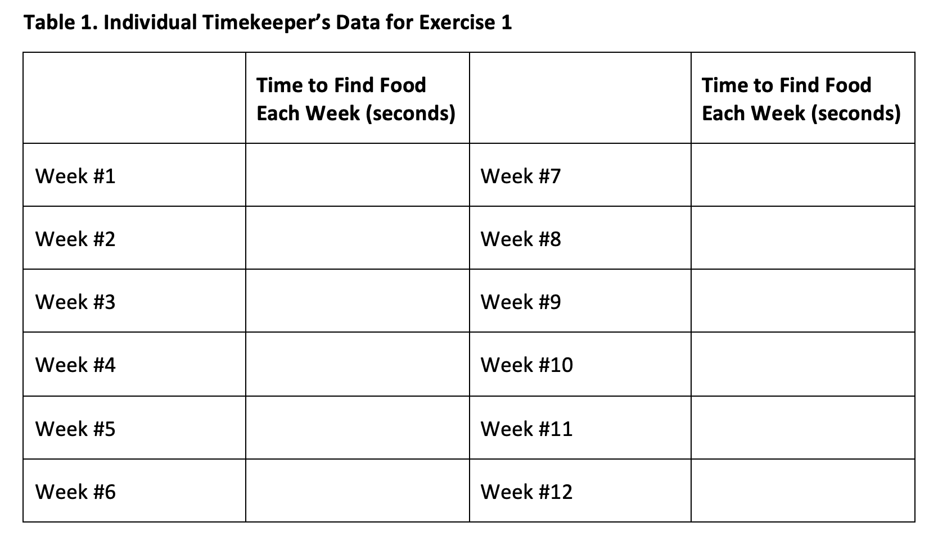
Data You Are Collecting & Collating

Slide 11
Let’s Go Forage!

Slide 12
Instructors’ Information
Students should take pre-measured containers of food, a clipboard, nest box, and a data sheet with them to the marked sites.
Onsite, have pairs pick their nesting site, then have one member scatter food randomly that their partner will forage for.

Slide 13
Instructors’ Information, cont.
Students should make predictions for the pre-exercise questions before starting the simulation.
  Tip: it may help students make better predictions if you let them complete the first week of foraging, THEN work on the questions.
Remind timekeepers to write down results every “week”. Ask if they have it done before starting the next round.
Occasionally ask what “week” is coming up, so students do not get behind or place data in the wrong week.

Slide 14
Instructors’ Information, cont.
At the end of each 12-week simulation have students:
  Enter their team’s data in a shared spreadsheet;
  Gather around and report out what happened: who “died,” how long foraging took, etc.; and
Answer the debrief questions about the simulation they just completed.
Do not go on to the next simulation until all groups have at least rough answers to the debrief questions.

Slide 15
Lab Debrief
What did you predict vs. observe in Exs. 1-3?
Given what you saw, are these true or false? Why?
  Selection causes new variations to appear.
  Selection always favors the one best solution to survival.
If selection is going on all the time:
  Why do some populations change but not others?

Slide 16
For Instructors: Branching Options We ID’ed
AFTER Exercise 1
  Effects of environmental changes
  (colder, stormier, drier winter)?
  What if whatsits compete, cooperate?
AFTER Exercise 2
  Effects of higher food demands?
  Effects of ample vs. scarce food?
  F/X sexual selection on mouthparts size?
  F/X of random drift on H/W equil.
    Run Ex. 2 twice; 1 plot randomly
    has “accident” or predation
    How is gene pool changed?
AFTER Exercise 3
  Effects of selection on gene pool?
  Two co-dominant alleles (G, H) control ph’type
    GG=knife, GH=spoon, HH=fork
  Two genes control ph’type:
    G controls blade. G_ = wide, gg = narrow (knife)
    H controls tines. H_ = no-tines, hh = tines (fork)
Modeling, statistics
  Calculate Shannon diversity (H), Simpson dominance (D) indices pre/post-selection.
  Students calculate allele freqs. pre/post- selection, predict mating outcomes for spring
  Compare results b/w one vs. multiple sections

Slide 17
THANKS for coming today!
Check out add’l info, resources in ABLE 24’s workshop folder
Fill out evaluation!
Notes:
1920 x 1080

